Slide 1

Mental Health Stress Prediction Using ML
Sadman Sakib Exam Roll: 245406
SUPERVISOR: Dr. Emon Kumar Dey
SPL1 Final PRESENTATION, 2025
Institute of Information Technology, University of Dhaka

Slide 2
Project Overview
Project Goal
Develop a machine learning system to predict student stress levels (Low, Moderate, High) using demographic and psychological data.
Key Highlights
• Dataset: A survey-based dataset (MHP Dataset) of 2,028 Bangladeshi university students across 15 institutions
• Approach: From-scratch implementation in Java (no ML libraries)
• Models: Decision Tree, Logistic Regression, K-Nearest Neighbors
• Methodology: 10-Fold Cross-Validation with iterative optimization
• Best Performance: 72.8% recall for Low stress, 78.9% for High stress (Act 4)

Slide 3
Dataset Overview
Academic Features
• Current CGPA
• Waiver/Scholarship
• University
• Department
Demographic Features
• Age
• Gender
• Academic Year
Psychological Features
• Anxiety Value
• Depression Value
Target Feature
• Stress Label

Slide 4
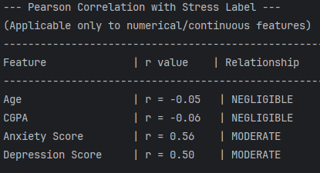
Feature Selection
Feature Selection Process:
Pearson Correlation with Stress Label
1.Pearson Correlation Analysis:
Pearson Correlation :
Quantifies linear relationship strength between features and stress (-1 to +1)
Applied to nominal & continuous features:
Age , CGPA , Anxiety Value , Depression Value
✅ Keep Anxiety Score and Depression Score
Clear linear trend

Slide 5
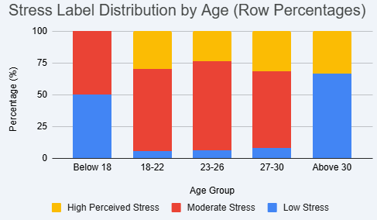
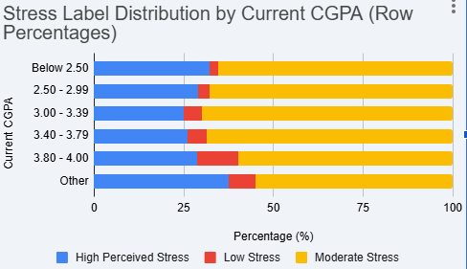
Feature Analysis: Age & CGPA
•Across ALL CGPA ranges, the distribution looks nearly identical — dominated by Moderate Stress (yellow) with similar High/Low ratios
•"Below 18" has ~50% Low Stress (blue is huge)
•"18–22" Low Stress almost disappears
•"Above 30" Low Stress shoots back up again
✅ Keep Age
U-shaped / non-linear pattern
✅ Keep CGPA
Domain Relevance

Slide 6
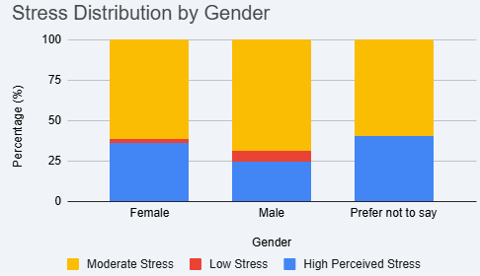
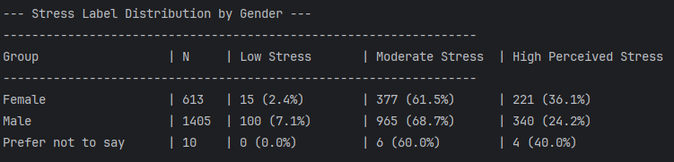
Feature Analysis: Gender & Distribution
2. Group Distribution Analysis
For categorical features:
Gender, Waiver/Scholarship, Academic Year
Stress Label Distribution by Gender
KEEP ✅
•Females: 36.1% High Stress — noticeably higher
•Males: 24.2% High Stress — lower
•The gap is ~12 percentage points, which is meaningful

Slide 7
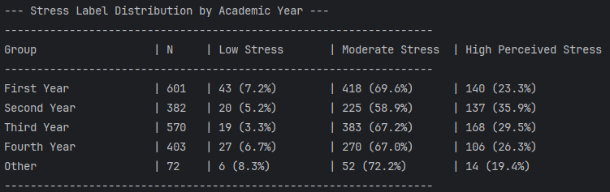
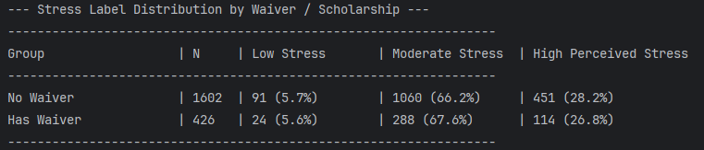
Feature Selection: Final Summary
Stress Label Distribution by Academic Year
Stress Label Distribution by Waiver
❌ Excluded
Non-linear spike in 2nd year , but weak Discriminative Power
❌ Excluded
Almost no Discriminative Power
Final Selected Features (5)
Age • Gender • CGPA • Anxiety Value • Depression Value
University and Department excluded to avoid institutional bias and maintain generalizability

Slide 8
Model Implementation
Three Algorithms Implemented from Scratch in Java
Decision Tree
Logistic Regression
K-Nearest Neighbors
Initial: maxDepth = 10
Optimized: maxDepth = 5
Softmax + SGD
Epochs: 500, LR: 0.01
Initial: k = 5
Optimized: k = 21
•handles non-linear patterns (eg age)without normalization
•widely used in health classification
•revealing the critical impact of normalization on model performance
•mental health screening is naturally a peer-comparison problem

Slide 9
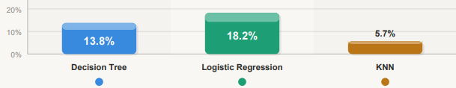
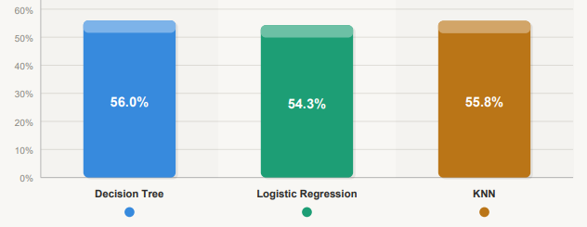
Model Evaluation Methodology
Act 1: Imbalanced Data — High Accuracy, Poor Minority Recall.
Low Stress — Recall
10-Fold Cross-Validation
Data split into 10 folds;
each fold serves as test
set once while remaining
9 folds train the model.
High Stress — Recall
Iterative Pipeline (3 Acts)
Act 1: Imbalanced (baseline)
Act 2: Balanced + Normalized
Act 3: Optimized (Tuned params)

Slide 10
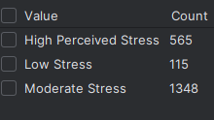
Dataset Challenge: Class Imbalance
Observation: Severe Imbalance Detected
Stress Label Distribution:
Class | Count | Percentage
High Perceived Stress | 565 | 27.9%
Low Stress | 115 | 5.7%
Moderate Stress | 1348 | 66.5%
Impact on Model Performance
• Models biased toward Moderate class
• Poor recall for Low and High stress
• Misses critical at-risk students
Stress Label Distribution in intellij idea

Slide 11
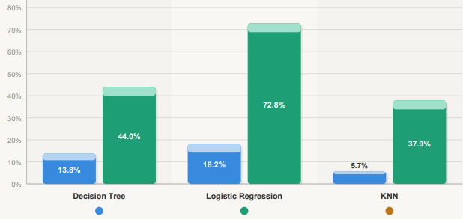
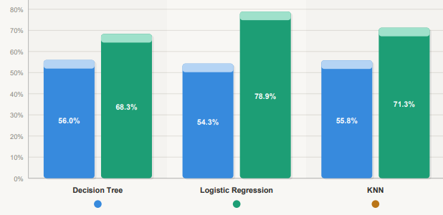
Preprocessing: Normalization & Balancing
Act 2: Min-Max Normalization + Oversampling
Duplicates minority class samples (Low, High stress) to match majority class (Moderate), eliminating bias toward dominant class and Scales all features to [0,1] range
Low Stress — Recall
High Stress — Recall
Observation: Balancing + normalization dramatically boosts Low-stress recall (up to +54 pp for LR) and moderately improves High-stress recall across all models.

Slide 12
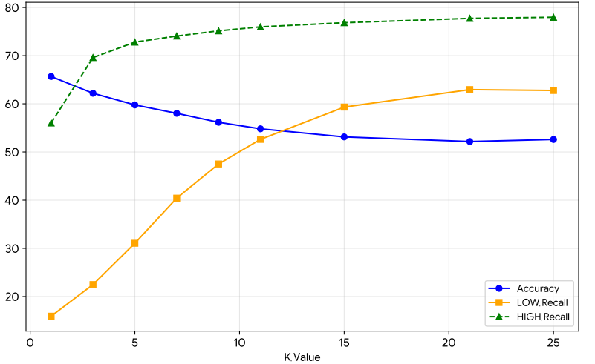
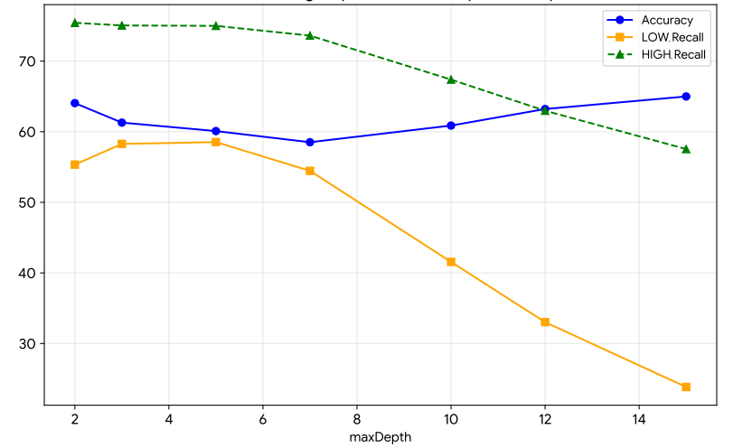
Hyperparameter Tuning
Grid Search to Optimize Minority Class Recall
KNN: k Parameter Tuning
Decision Tree: maxDepth Tuning
Optimal k = 21 (maximizes minority recall)
Optimal maxDepth = 5 (balances recall)
Logistic Regression: No hyperparameters tuned (learning rate & epochs fixed at 0.01 and 500)

Slide 13
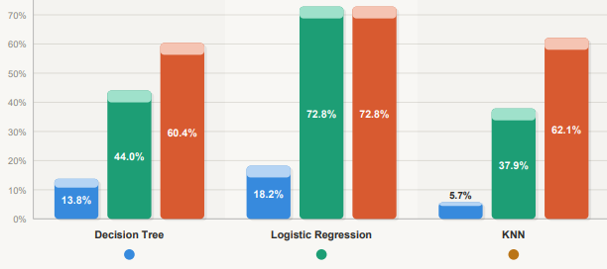
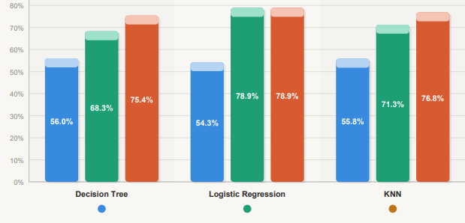
Final Results
Act 3: Optimized Models: Balanced + Normalized + Tuned Parameters (maxDepth=5, k=21)
High Stress Recall — Essential for Risk Identification
Low Stress Recall — Critical Metric for Early Detection
Further tuning (Act 3) closes the gap for DT and KNN on both classes, making all three models competitive, while LR peaks at Act 2 and gains nothing from tuning.

Slide 14
TIME TO PREDICT WITH THE MOST OPTIMIZED MODEL
Thank You
Questions & Discussion
Sadman Sakib • Roll 245406
Supervisor: Dr. Emon Kumar Dey
Institute of Information Technology, University of Dhaka

